Slide 1



Introducere în analiza datelor de mari dimensiuni
Titlul proiectului: Educație și dezvoltare în era digitală
Cod proiect: POCU/860/3/12/143072
Exploratory Data Analysis in R
By Marin Fotache

Slide 2
Agenda
Get basic information about variables
Descriptive Statistics (central tendency/ locality; data spread /dispersion/variation; distribution shape) for:
nominal data
ordinal data
interval/ratio data
Measuring association
Missing values treatment
Extreme/wrong values treatment
How to `read` information displayed in graphs (finding problems/issues)

Slide 3
Two `classic` flavours of statistics
Descriptive statistics - summarizing data in a compact understandable fashion (way)
Centrality of data
Spreading of data
Distribution of data
Inferential statistics – estimating the values of population parameters based on samples of that population
Based on probability theory
Deals with hypothesis testing

Slide 4
Start with these resources
Hadley Wickham and Garrett Grolemund (2022). R for Data Science (https://r4ds.hadley.nz)
10 Exploratory data analysis
Mine Çetinkaya-Rundel and Johanna Hardin (2021-2022). Introduction to Modern Statistics (https://openintro-ims.netlify.app/index.html)
4 Exploring categorical data
5 Exploring numerical data
Chester Ismay and Albert Y. Kim (2022). Statistical Inference via Data Science. A ModernDive into R and the Tidyverse (https://moderndive.com/index.html)
Only sections: 5.1.1, 5.2.1, 6.1.1, 6.2.1

Slide 5
Resources on Descriptive Statistics in R
Descriptive Statistics for Data Science (Ankit Rathi)
https://medium.com/analytics-vidhya/descriptive-statistics-for-data-science-2f304a36ac34
Daniel J. Navarro- Learning statistics with R: A tutorial for psychology students and other beginners. (Version 0.6.1) (2018)
Chapter 5 Descriptive statistics
https://bookdown.org/ekothe/navarro2/descriptives.html
Descriptive Statistics (Salvatore S. Mangiafico)
http://rcompanion.org/handbook/C_02.html
Summary Statistics in R: Mean, Standard Deviation, Frequencies, etc (R Tutorial 2.7)
https://www.youtube.com/watch?v=ACWuV16tdhY&index=19&list=PLqzoL9-eJTNBDdKgJgJzaQcY6OXmsXAHU
Descriptive/Summary Statistics with descriptr
https://blog.rsquaredacademy.com/introducing-descriptr/

Slide 6
Descriptive statistics
Measures of central tendency
Mean
Median
Mode
Measures of variability
Range (the biggest value minus the smallest value.)
Interquartile range
Mean absolute deviation
Variance
Standard deviation
Median absolute deviation

Slide 7
Descriptive statistics (cont.)
Measures of the shape of variable distribution
Skew
Kurtosis
Measures of association/link/relation between variables
Covariance
Correlation
Pearson’s correlation coefficient
Spearman’s rank correlation coefficient
Kandall's tau correlation coefficient

Slide 8
What Measure to Use? (Navarro, 2018)
Range. Gives you the full spread of the data. It’s very vulnerable to outliers, and as a consequence it isn’t often used unless you have good reasons to care about the extremes in the data.
Interquartile range. Tells you where the “middle half” of the data sits. It’s pretty robust, and complements the median nicely. This is used a lot.
Mean absolute deviation. Tells you how far “on average” the observations are from the mean. It’s very interpretable, but has a few minor issues that make it less attractive to statisticians than the standard deviation. Used sometimes, but not often.
Variance. Tells you the average squared deviation from the mean. It’s mathematically elegant, and is probably the “right” way to describe variation around the mean, but it’s completely uninterpretable because it doesn’t use the same units as the data. Almost never used except as a mathematical tool
Standard deviation. This is the square root of the variance. It’s fairly elegant mathematically, and it’s expressed in the same units as the data so it can be interpreted pretty well. In situations where the mean is the measure of central tendency, this is the default. This is by far the most popular measure of variation.
Median absolute deviation. The typical (i.e., median) deviation from the median value. In the raw form it’s simple and interpretable; in the corrected form it’s a robust way to estimate the standard deviation, for some kinds of data sets. Not used very often, but it does get reported sometimes.

Slide 9
Choosing between Mean and Median (Navarro, 2018)
When data are nominal scale – do not use either. Sometimes mode could prove useful
When data are ordinal scale, median is usually more adequate than the mean. The median only makes use of the order information in the data, but doesn’t depend on the precise numbers involved.
For interval and ratio scale data, either one is generally acceptable. The mean has the advantage that it uses all the information in the data (which is useful when you don’t have a lot of data), but it’s very sensitive to extreme values

Slide 10
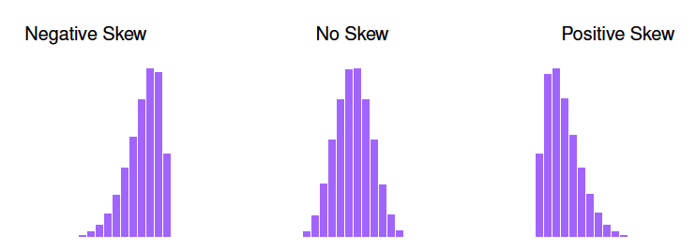
Skewness
Masures the asymmetry of the distribution of a variable
Function skew in package psych
> library(psych)
> skew(faithful)
[1] -0.4135 -0.4140

Slide 11
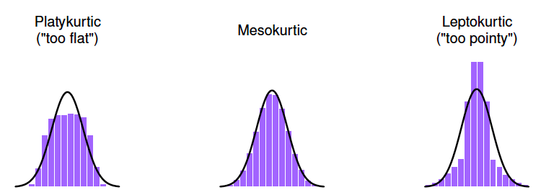
Kurtosis
Masures the "flatness" of the distribution of a variable
Function kurtosi in package psych
> library(psych)
> kurtosi(faithful)
eruptions waiting
-1.512 -1.156
Positive kurtosis
negative kurtosis
Zero kurtosis

Slide 12
Exploratory Data Analysis
An iterative cycle (Grolemund & Wickham, 2017)
Generate questions about your data.
Search for answers by visualizing, transforming, and modelling your data.
Use what you learn to refine your questions and/or generate new questions.
Main goal during EDA is to develop an understanding of data
Not a formal process with a strict set of rules
Two main types of questions:
What type of variation occurs within my variables?
What type of covariation occurs between my variables?

Slide 13
Resources on Exploratory Data Analysis
Tidy Tuesday Screencast: analyzing college major & income data in R (David Robinson) (2018)
https://www.youtube.com/watch?time_continue=1&v=nx5yhXAQLxw
Garrett Grolemund, Hadley Wickham - R for Data Science, O’Reilly (2017) - 7 Exploratory Data Analysis
https://r4ds.had.co.nz/exploratory-data-analysis.html
Pablo Casas - Data Science Live Book (2018)
https://livebook.datascienceheroes.com/exploratory-data-analysis.html
1 Exploratory Data Analysis
2 Data Preparation
Chester Ismay and Albert Y. Kim - An Introduction to Statistical and Data Sciences via R (2018)
7.1.1 Exploratory data analysis
https://moderndive.com/7-multiple-regression.html
Patrick Meyer - Exploratory Data Analysis (2015)
https://www.youtube.com/watch?v=zHcQPKP6NpM

Slide 14
Packages for Exploratory Data Analysis
A comprehensive view (at the beginning of 2019)
The Landscape of R Packages for Automated Exploratory Data Analysis (Mateusz Staniak and Przemysław Biecek)
https://arxiv.org/pdf/1904.02101v1.pdf
Other resources on EDA packages
explore
https://cran.r-project.org/web/packages/explore/vignettes/explore.html
DataExplorer
https://boxuancui.github.io/DataExplorer/
https://www.programmingwithr.com/how-to-automate-eda-with-dataexplorer-in-r/
Exploratory Data Analysis & Data Preparation with 'funModeling’
https://blog.datascienceheroes.com/exploratory-data-analysis-data-preparation-with-funmodeling/
Simple EDA in R with inspectdf
https://www.littlemissdata.com/blog/inspectdf

